Slide 1
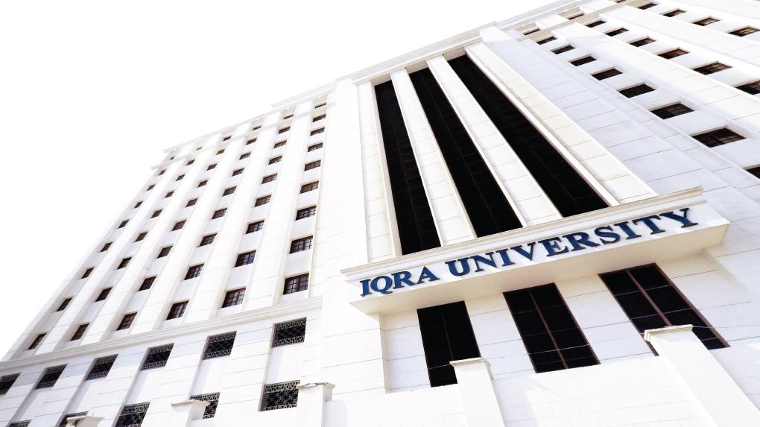

Diagrammatic representation of sets by Venn diagram
LECTURE 2
Adapted from :
https://www.genrica.com/vustuff/MTH202/MTH202_handouts_1_45.pdf

Slide 2
Learning Outcomes
After completing this lecture satisfactorily, a student will:
• Be able to specify and manipulate basic mathematical objects such as sets,
functions, and relations and will also be able to verify simple mathematical
properties that these objects possess.
• Gain experience in using various techniques of mathematical induction (weak,
strong and structural induction) to prove simple mathematical properties of a
variety of discrete structures.

Slide 5
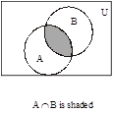

Slide 10
Exercise:
A number of computer users are surveyed to find out if they have a printer, modem or scanner. Draw separate Venn diagrams and shade the
areas, which represent the following configurations.
modem and printer but no scanner
scanner but no printer and no modem
scanner or printer but no modem.
no modem and no printer.
SOLUTION
Let
P represent the set of computer users having printer.
M represent the set of computer users having modem.
S represent the set of computer users having scanner

Slide 11
(i)
Modem and printer but no Scanner is shaded.
(ii)
Scanner but no printer and no modem is shaded.

Slide 12
(iii)
scanner or printer but no modem is shaded.
(iv)
no modem and no printer is shaded.

Slide 13
Review Questions
Can you explain Van diagram for Union , Intersection.
Van Diagram for compliment

Slide 14
Thank you

